Slide 1
Flexible Instruction –
Creating New Opportunities for Student Success
Transforming Classrooms...
Transforming Lives!

Slide 4
Flexible Instruction with Blended Curriculum
+
Use your Phone or Tablet! ☺
…

Slide 5
For the Teacher
Traditional Components
Burlington Core Components
=

Slide 6
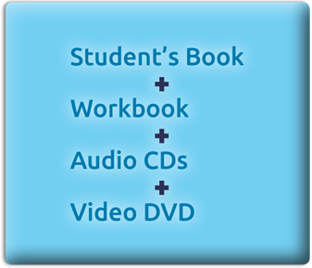
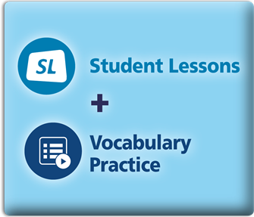
For the Student
Traditional Components
Burlington Core Components
=

Slide 8
Content for every need!
Burlington Core
English in America
Career Explorations and Soft Skills
Digital Readers
Prepare for CASAS
English for Specific Careers
Using Your Computer
Cutting Edge Speech Trainer
Reports for State and Federal Compliance

Slide 9
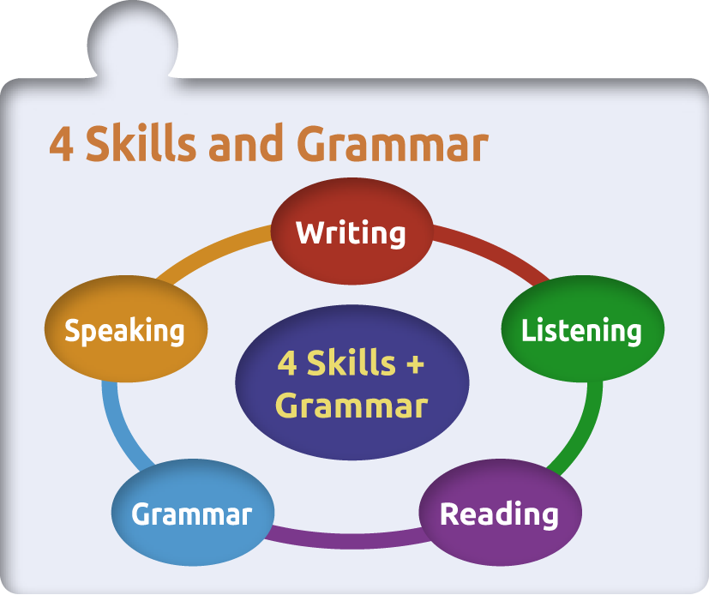
Innovation made easy!

Slide 10
Utah Pilot Statistics
4 programs
6 teachers
96 students
Start date: Sept. 1st

Slide 11
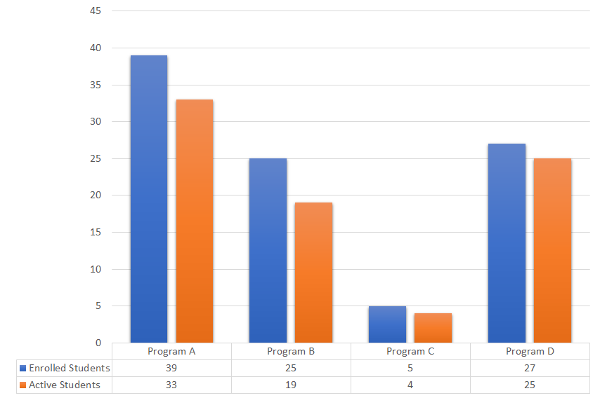
81 of the 96 enrolled students were active in Burlington in September

Slide 12
Program D
Program A
Program C
77.0 total teacher hours in Burlington in September
Program B

Slide 13
Program A
Program D
362.25 total student hours in Burlington in September
Program C
Program B

Slide 14
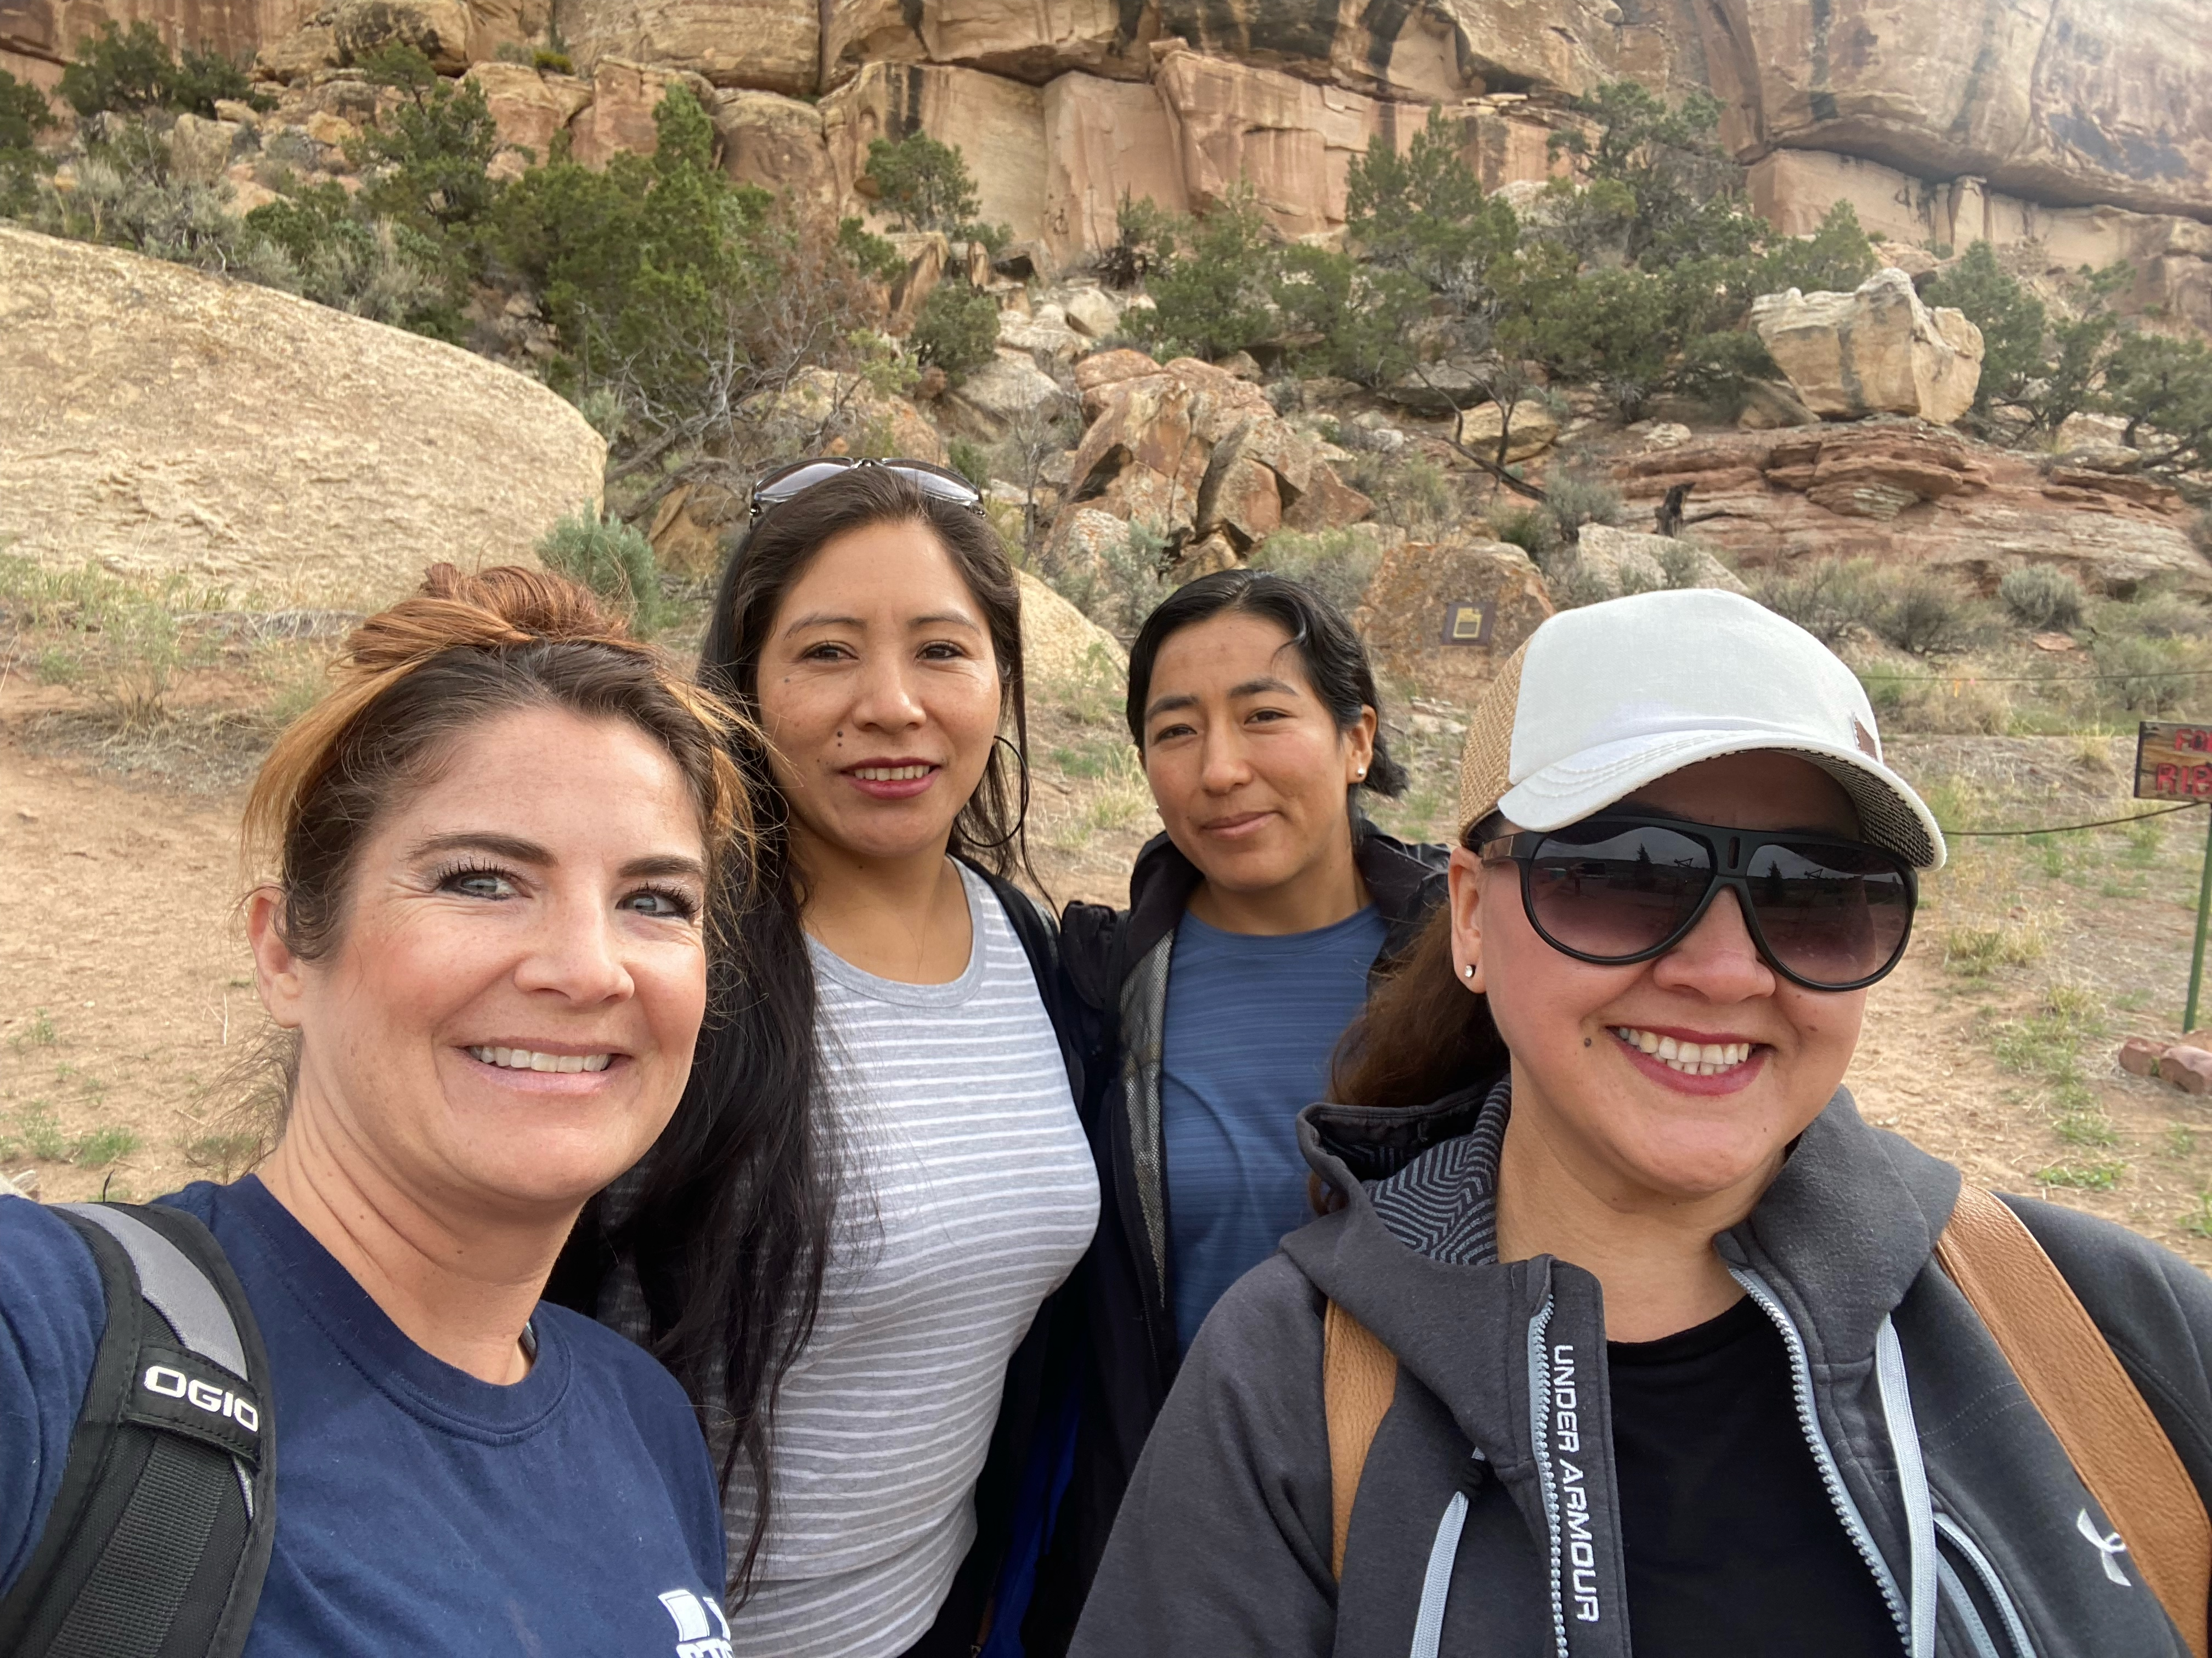
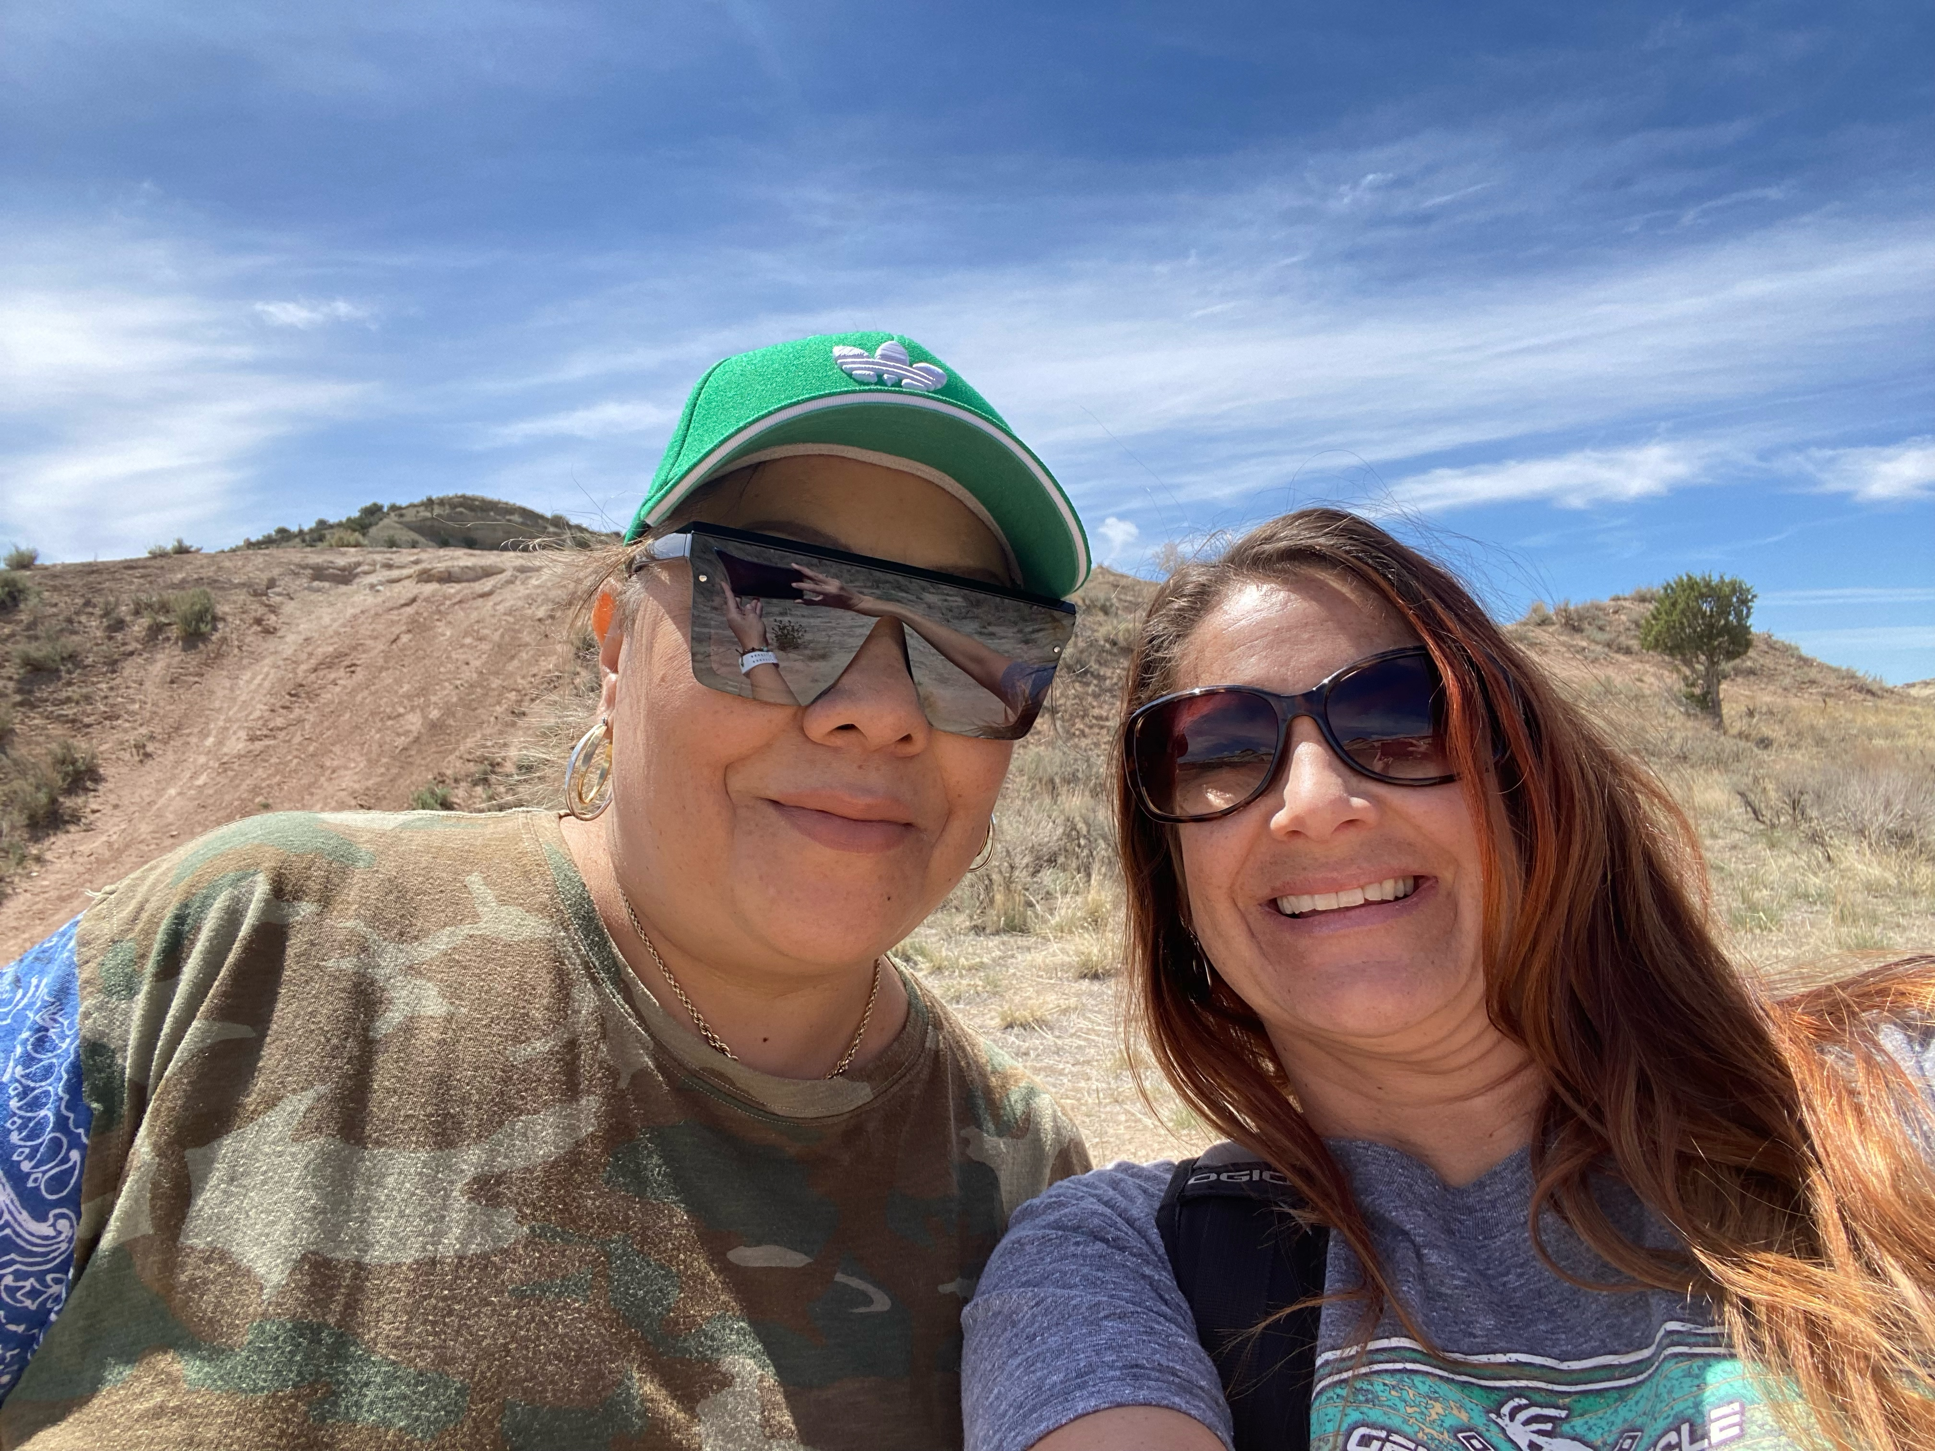
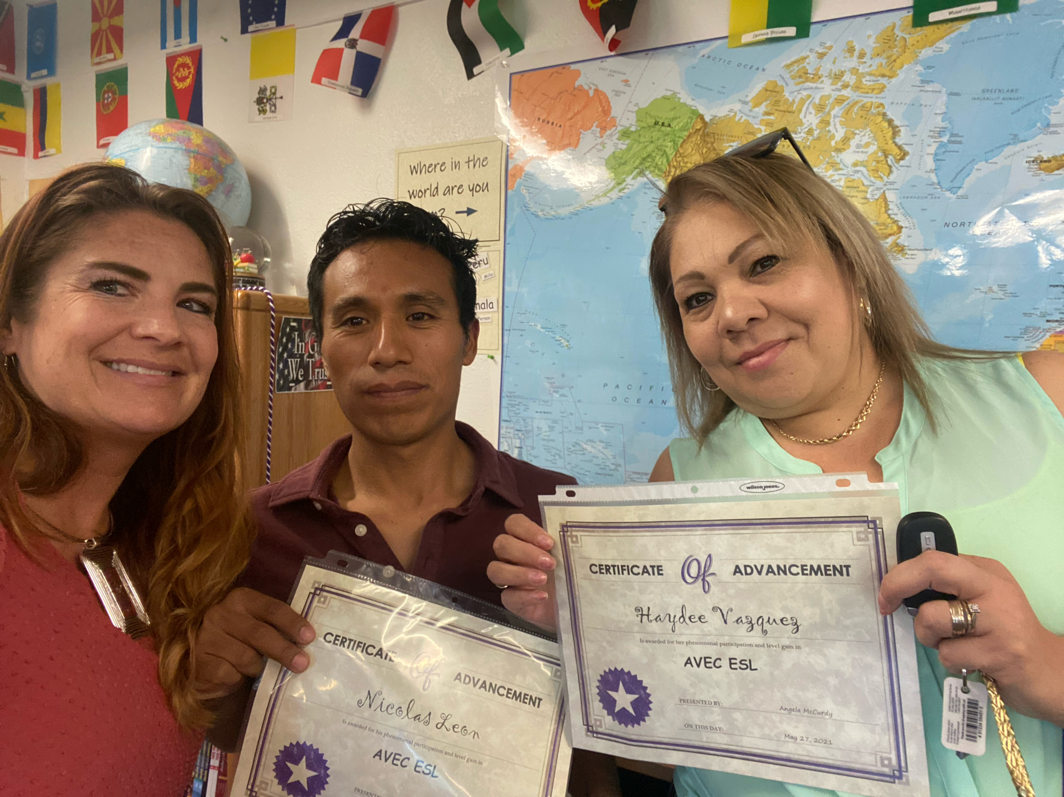
Teacher Spotlight with Angela McCurdy
Ashley Valley Education Center
Multilevel teacher
Rural program
Face-to-Face Classes

Slide 15
Initial Training for Teacher Success
Teaching with Burlington English
Learn how to teach with In-Class lessons
Explore navigation and unique features
Discuss engagement strategies
Getting Students Started with Burlington English
Explore navigation specific to Student Lessons
Discuss best practices for connecting ICLs to Student Lessons

Slide 16
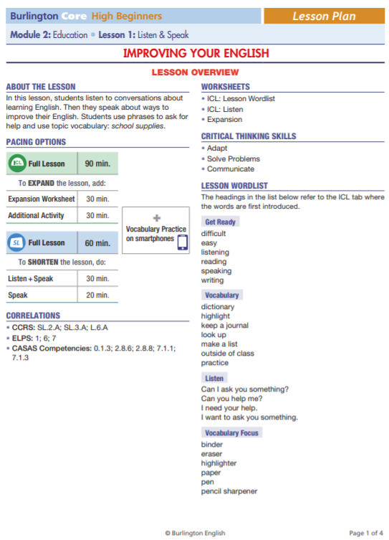
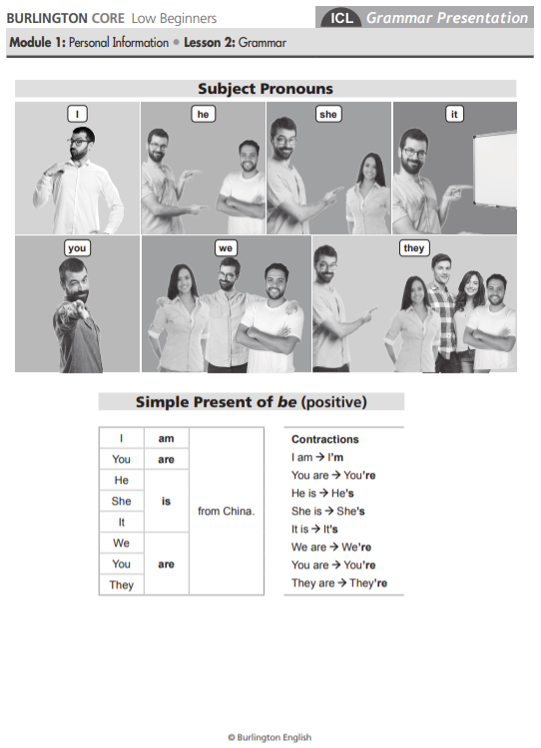
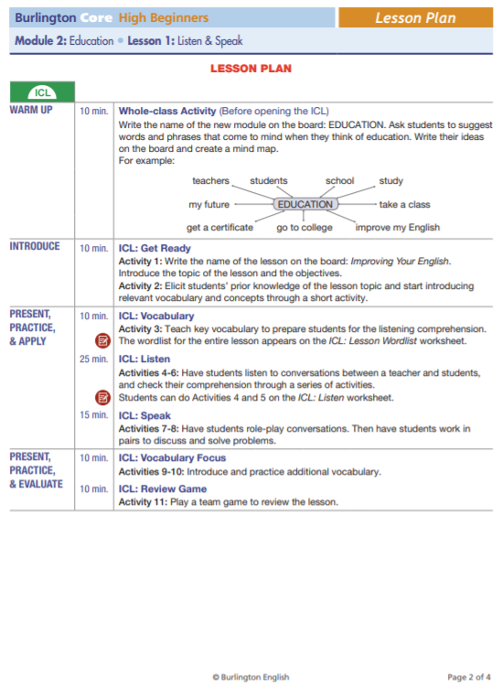
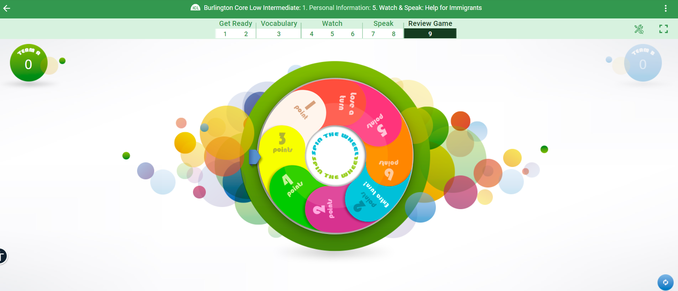
Teaching Made Easy with Burlington
Take the stress out of prep using:
Lesson plans
Worksheets
Games

Slide 17
Plan for Student Success with Student Orientations
Virtual orientation
Walk students through best practices for:
Logging in on all devices
Student Lessons
Activity navigation
Recording

Slide 18
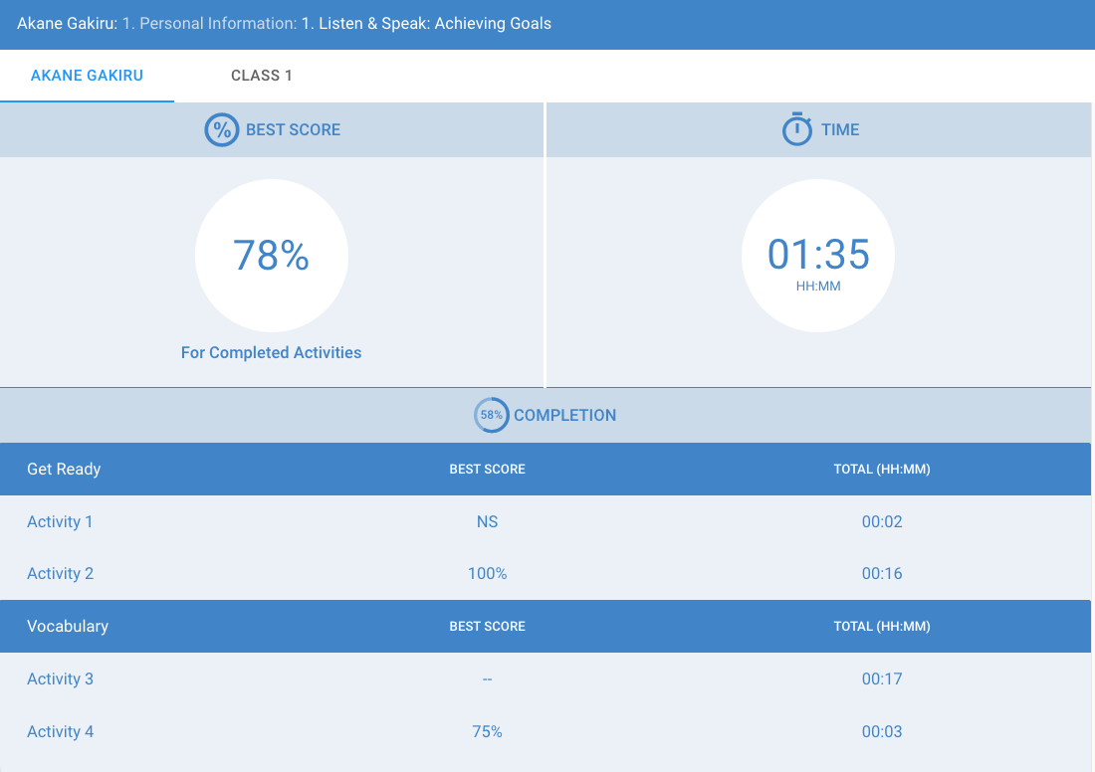
Communicating Student Expectations
Setting student expectations
Hours spent per week
Checking progress
Recognition

Slide 19
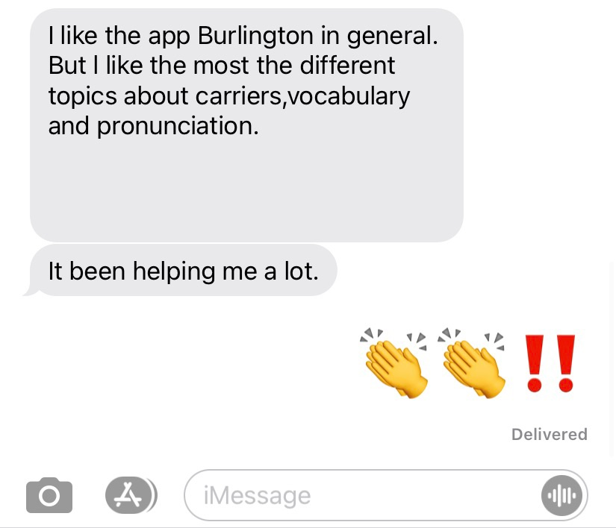
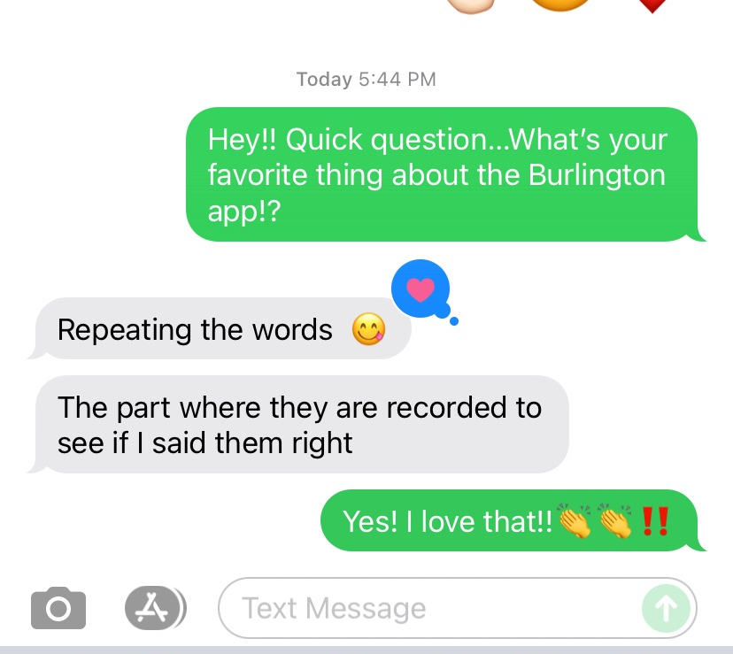
Student Sentiments

Slide 20
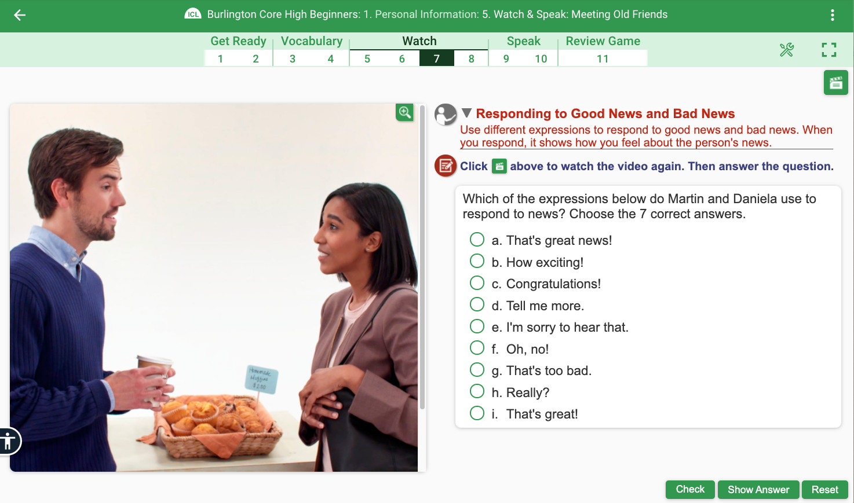
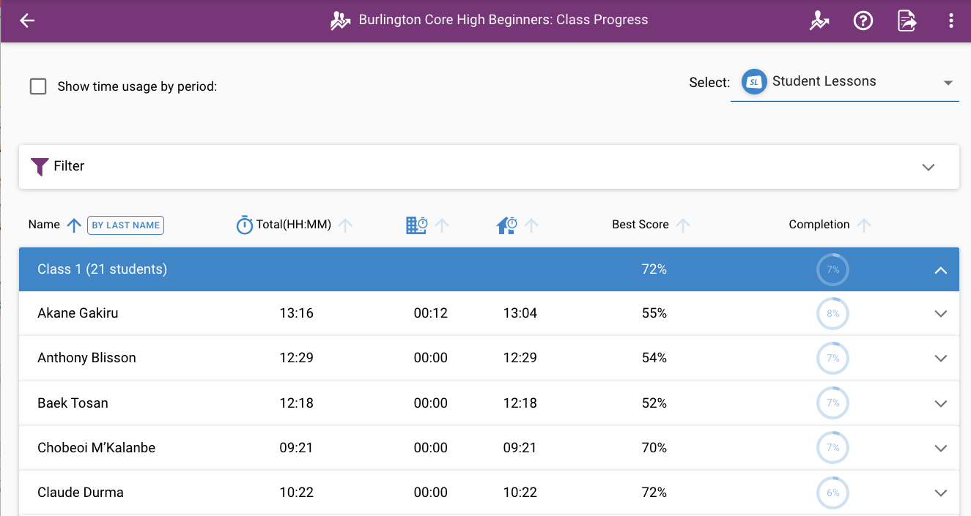
Continued Support with Ongoing Training
​
Understanding Student Progress & Reports
Bringing Burlington Core In-Class Lessons to Life!
Creating a BurlingtonEnglish Career Blend
And That's Not All!

Slide 21
Unmatched Customer Support
at your Fingertips!
On-Demand Training
Learn at your own pace – start, stop, and resume a course as your schedule allows
Review any part of a course at any time
Access courses from any device
Virtual Training
Attend live topic-specific trainings​
Join a training when convenient for you
Interact remotely with Burlington representatives
Collaborate with adult educators across the nation​
One-on-One Support & Training
Strategize with your BurlingtonEnglish representative to:​
Customize an implementation plan for your program​
Choose the most appropriate course material for your students​
Explore ways to maximize student usage and promote learning gains​

Slide 23
